Slide 1
Introduction to the course(LIS-405)
Information Communication Technology(Theory and Practice)

Slide 2

Objectives of the course
To introduce with the basics of ICT and related issues.
To study Hypertext, Hypermedia, Multimedia and file formats.
To understand Open Source Software.

Slide 3
Course Content - Theory
Evolution of digital computers : computer Hardware, Software, Stirage devices abd their applications in libraries.
Operating systems : Linux, Windows, Shell Programming.
Computer software applications : Microsoft office and open office
Hypertext, Hypermedia, Multimedia and File formats, User Interfaces and data visualization.
Networks and networking concepts; Internet; World Wide Web; Search Engines.
Open source Software applications in libraries

Slide 4
Course content - Practical
Operation of computers and connecting the various components
Linux and Windows Installation
MS Office and Open Office
Web Searching and evaluation

Slide 5
Method of Teaching
Lectures
Practical Sessions
Seminars
Projects

Slide 6
Method of Assessment
Assignment – five to six assignments
Presentation – one group presentation and one individual presentation
Written sessional tests – minimum two
Attentiveness and performance in the Practical sessions
Practical test - minimum two
End Semester examination
Written exam for theory
Practical exam for practice

Slide 7
Reading list
Computer Fundamentals by P.K. Sinha
Using Information Technology by Brian K. Williams and Stacy C. Sawyer (6th Edition)
Introduction to computers by Peter Norton

Slide 8
Questions??

Slide 9
Introducing computers
“Computers are everywhere”
Notes:
Past two decades, computers have reshaped our lives at home, work, and school.
Business, airlines, railways, entertainers, manufacturers, food processing plants, in the car, washing machines, etc.

Slide 10
Outline
Definition of computer
Types of computers
On the basis of representation of data
Computers for individual users
Computers for organizations
Evolution of digital computers (history)
The Zeroth Generation (The Mechanical Era)
First generation electronic computers
Second generation
Third generation
Fourth Generation
Fifth generation

Slide 11
Definition
Computer derives its name from the word Compute that means calculation.
A computer is an electronic device that processes data, converting it into information that is useful to people.
A computer is an electronic device that processes or transforms data into useful information by executing a series of predefined instructions.
Programmable, multiuse machine that accepts data and figures and processes it into usable information.
There are two principal characteristics of a computer –
It responds to a specific set of instructions in a well-defined manner.
It can execute a prerecorded list of instructions.

Slide 12
Parts of a computer system
A complete computer system consists of four parts
Hardware
Software
Data
Users
Hardware : The mechanical devices that make up the computer. Any part of computer that you can touch. A computers HW consists of interconnected electronic devices that you can use to control the computer’s operation, input, and output.
Software : a set of instructions that makes the components perform tasks. The term Program refers to any piece of software.
Data : Data consist of individual facts or pieces of information that by themselves may not make much sense to a person. Computers main job is to process these in various ways.
Users : People are the computer operators also known as users. Sometimes the other computers are also called as user.

Slide 13
The IPO cycle
The input-process-output cycle is a set of steps the computer follows to receive data, process the data according to instructions from a program, display the resulting information to the user, and store the results.
Input
P
Output
Storage

Slide 14
Assignment
Write an essay on
“Application of computers in Education, Government, Health care, Banking and Home”

Slide 15
Types of computers
Computers can be categorized in several ways. For Example,
Number of users it can support
Computing Power
Size
Representation of data/operational principle
Can be further subdivided by
Price
Type of hardware
Kind of software they can run

Slide 16
Based on operational principle
Analog and Digital
Analog Computers:
The earliest computers were analog systems.
Represent data as variable points along a continuous spectrum of values.
Mainly mechanical in nature using motors, gears and other moving parts to solve equations.
Solves problems by using continuously changing data : such as Temperature, voltage, and Pressure.
Digital computers:
Represents data as having one distinct value or another with no other possibilities.
discontinuous or discrete data
They convert the data into digital signal (binary digits 0 and 1) and all operations are carried out on these digits at extremely fast rates.

Slide 17
Based on capacity, speed and reliability
Supercomputers
Mainframes
Workstation
Minicomputers
Microcomputers
Microcontrollers

Slide 18
Based on size
Desktop
Laptop
Palmtop
Server
Wearable

Slide 19
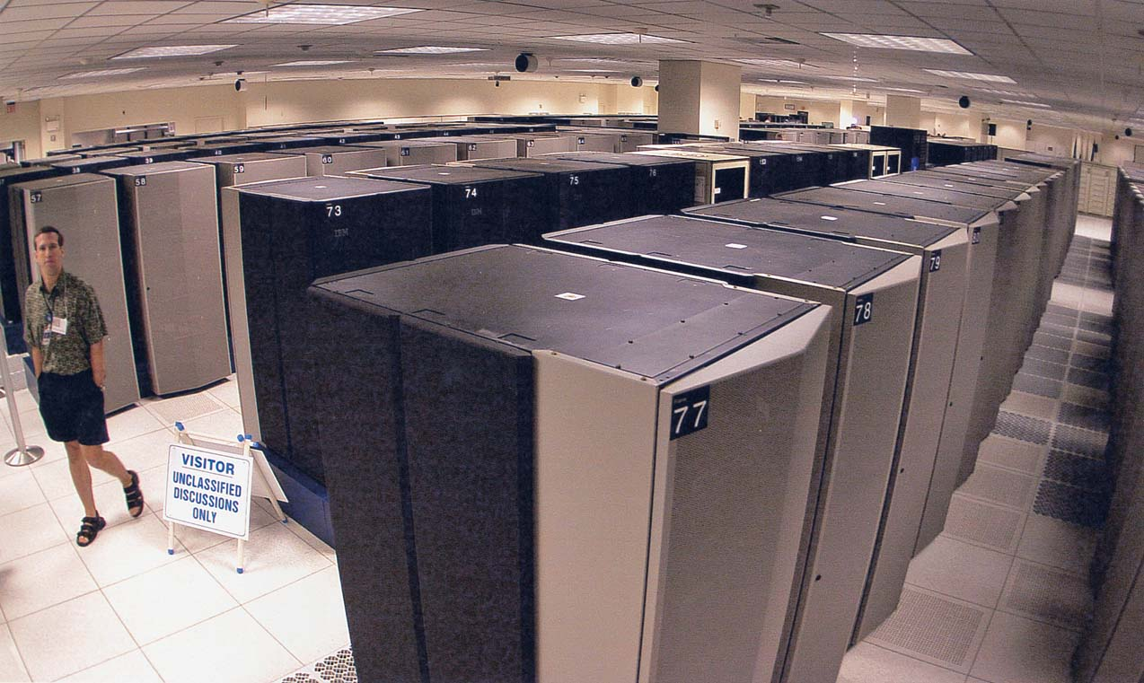
Supercomputers
High-capacity machines with hundreds of thousands of processors that can perform over 1 trillion calculations per second. E.g IBM ASCI White, Cray
Used where High Performance computing is required
Usually used for weather forecasting, Missile simulations, Nuclear Fusion simulations
IBM ASCI White
IBM ASCI White
Notes:
Computers are listed in decreasing order of size.
Supercomputer - typically priced from $500,000 to more than $85 million, supercomputers are high-capacity machines with hundreds of thousands of processors that can perform over 1 trillion calculations per second.
Picture caption: IBM ASCI (Accelerated Strategies Computing Initiative) White

Slide 20
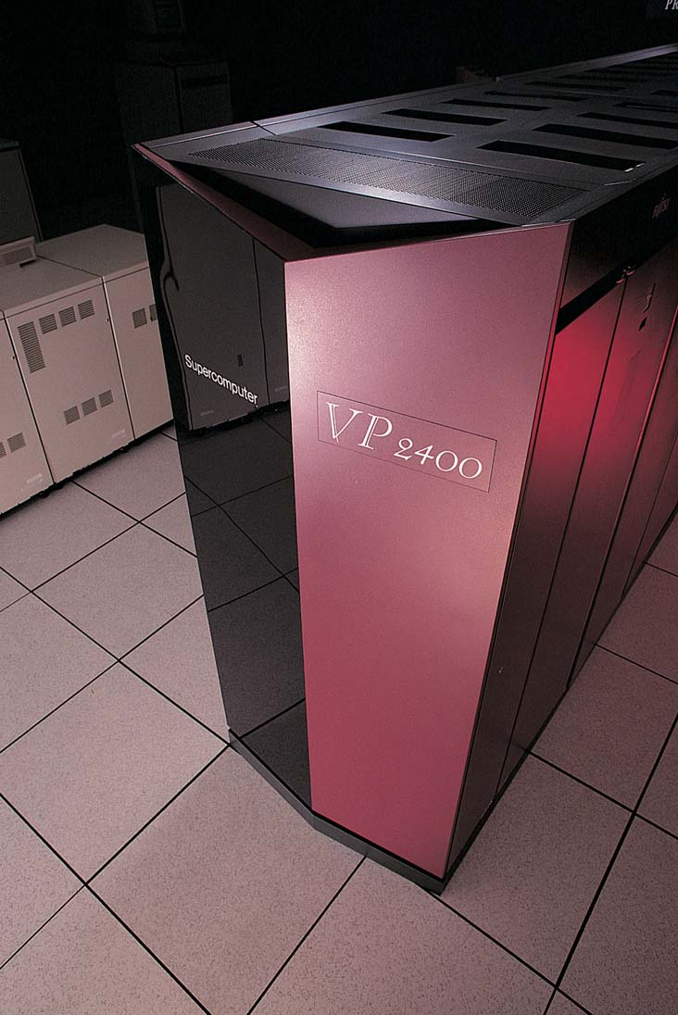
Mainframes
Water- or air-cooled computers that vary in size from small, to medium, to large, depending on their use.
E.g IBM AS/400
Normally Dumb Terminals are connected to these main frames. Processing is done by Main Frames
Dumb terminals only have keyboard, monitors
VP2400 mainframe
Notes:
Mainframe - water- or air-cooled computers that cost $5000 - $5 million and vary in size from small, to medium, to large, depending on their use.
Small mainframes used to be called minicomputers; today, they’re more frequently called midsize computers.
Terminal - means often used to access a mainframe. Consists of a display screen and a keyboard. A terminal can input and output data but cannot by itself process data.

Slide 21
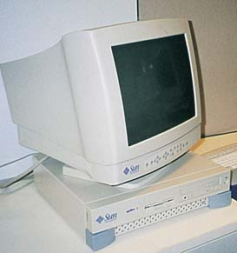
Workstations
Expensive, powerful computers usually used for complex scientific, mathematical, and engineering calculations and for computer-aided design and computer-aided manufacturing.
e.g. Sun blade 2500
Sun Microsystems workstation
Notes:
Workstations - expensive, powerful computers usually used for complex scientific, mathematical, and engineering calculations and for computer-aided design and computer-aided manufacturing.

Slide 22
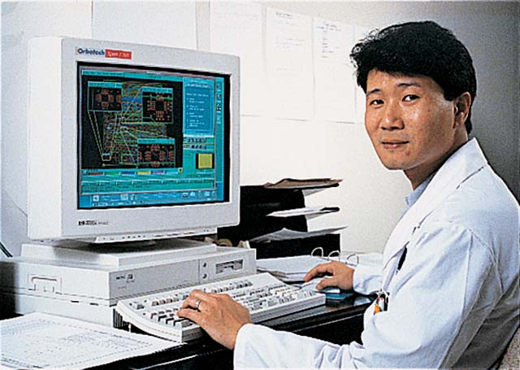
Microcomputers
A Desktop Personal Computer
Your home computers
Now Desktop and Workstations are combining. i.e Your PC is also becoming powerful enough
Notes:
Microcomputers - also called personal computers. Cost $500 - $5000. Can fit next to a desk or on a desktop, or can be carried around.
Tower PC - PC in which the case sits as a “tower,” often on the floor beside a desk, thus freeing up desk space.
FACTOID: Some computer manufacturers produce PCs called “mini-towers.”
Local area network (LAN) - a network connecting, usually by special cable, a group of desktop PCs and other devices, such as printers, in an office or a building.

Slide 23
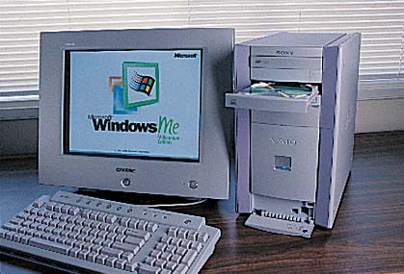
Microcomputers
A Tower Case Personal Computer
Sony tower PC
Notes:
Microcomputers - also called personal computers. Cost $500 - $5000. Can fit next to a desk or on a desktop, or can be carried around.
Tower PC - PC in which the case sits as a “tower,” often on the floor beside a desk, thus freeing up desk space.
FACTOID: Some computer manufacturers produce PCs called “mini-towers.”
Local area network (LAN) - a network connecting, usually by special cable, a group of desktop PCs and other devices, such as printers, in an office or a building.

Slide 24
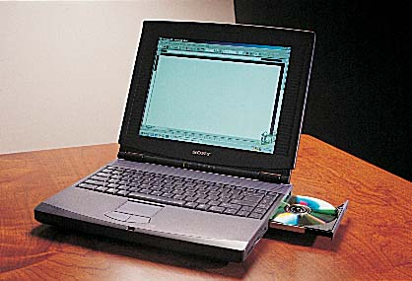
Microcomputers
A Laptop Personal Computer
Lightweight portable computers with built-in monitor, keyboard, hard-disk drive, SSD, battery and AC adapter.
Notes:
Microcomputers - also called personal computers. Cost $500 - $5000. Can fit next to a desk or on a desktop, or can be carried around.
Tower PC - PC in which the case sits as a “tower,” often on the floor beside a desk, thus freeing up desk space.
FACTOID: Some computer manufacturers produce PCs called “mini-towers.”
Local area network (LAN) - a network connecting, usually by special cable, a group of desktop PCs and other devices, such as printers, in an office or a building.

Slide 25
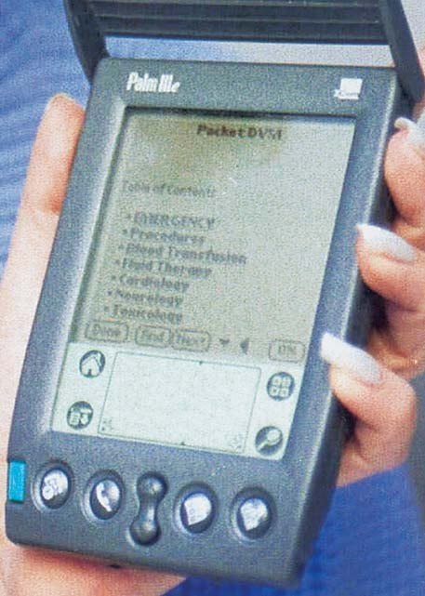
Microcomputers
A Personal Digital Assistant
Getting Very popular
Personal organization tools-schedule planners, address books, to-do lists, send e-mail and faxes.
New generation that incorporates mobile phone and microcomputer.
HP 5555
Notes:
Microcomputers - also called personal computers. Cost $500 - $5000. Can fit next to a desk or on a desktop, or can be carried around.
Tower PC - PC in which the case sits as a “tower,” often on the floor beside a desk, thus freeing up desk space.
FACTOID: Some computer manufacturers produce PCs called “mini-towers.”
Local area network (LAN) - a network connecting, usually by special cable, a group of desktop PCs and other devices, such as printers, in an office or a building.

Slide 26
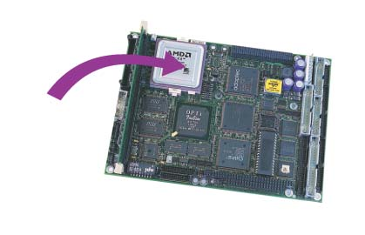
Microcontrollers
Embedded computers are the tiny, specialized microprocessors installed in "smart" appliances and automobiles.
Notes:
Microcontrollers - also called embedded computers. They are the tiny, specialized microprocessors installed in “smart” appliances and automobiles.

Slide 27
Evolution of computers
Each generation of computer is characterized by a major technological development that fundamentally changed the way computers operate, resulting in increasingly smaller, cheaper, more powerful and more efficient and reliable devices.

Slide 28

ZEROTH GENERATION
Man used fingers, ropes, beads, bones, pebbles and other objects for counting and calculations.
Abacus, Pascaline, Difference & Analytical engines,
Punched cards
Electricity was not yet invented

Slide 29
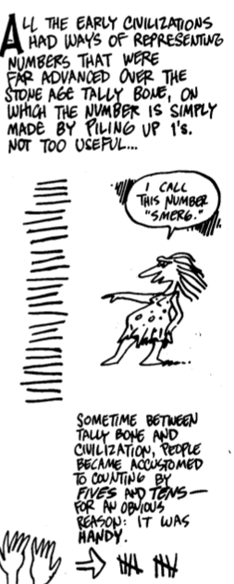
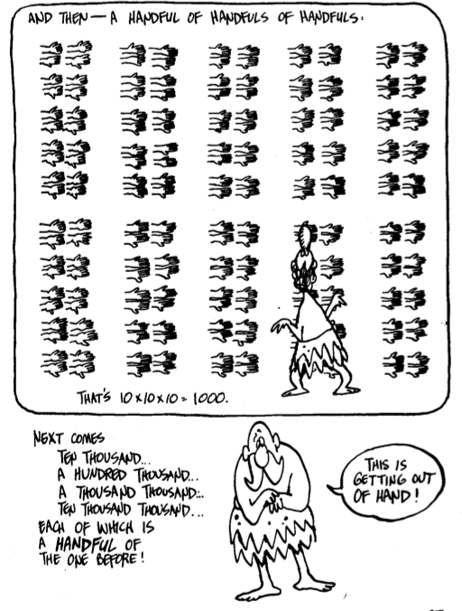

Slide 30
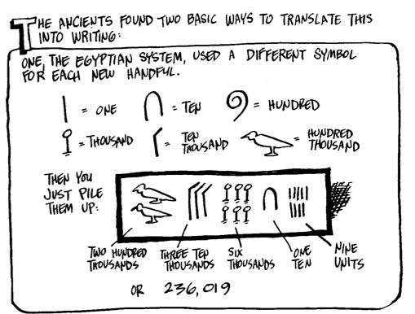

Slide 31
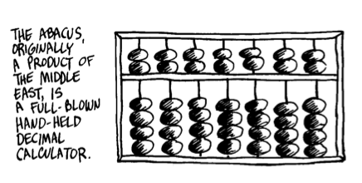
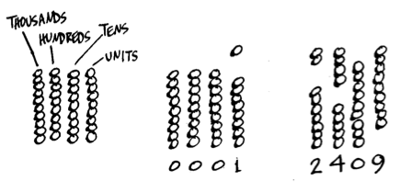

Slide 32
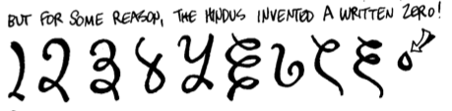

Slide 33
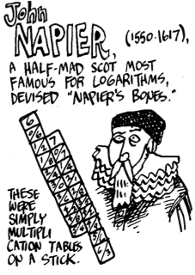
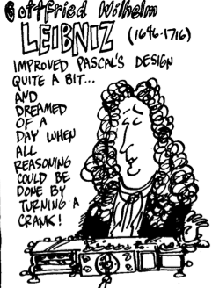
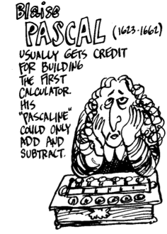

Slide 34
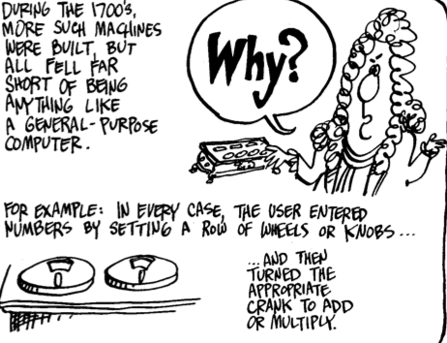

Slide 35

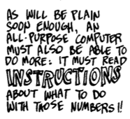

Slide 36
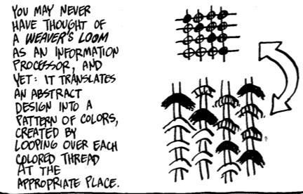
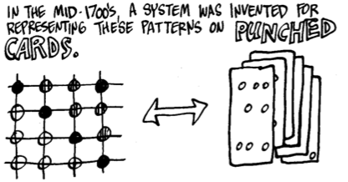

Slide 37
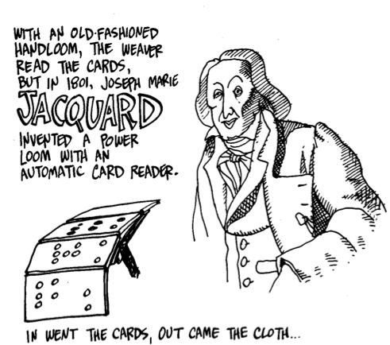

Slide 38
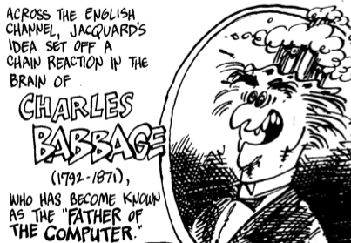
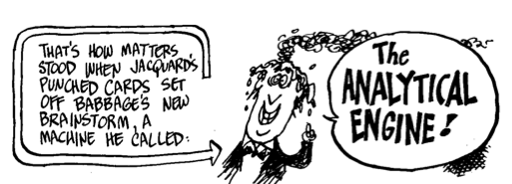

Slide 39
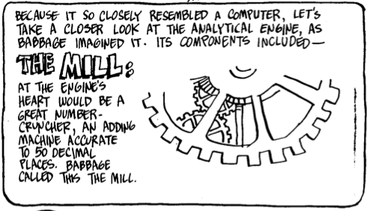



Slide 40
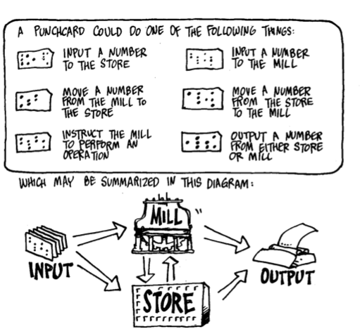

Slide 41
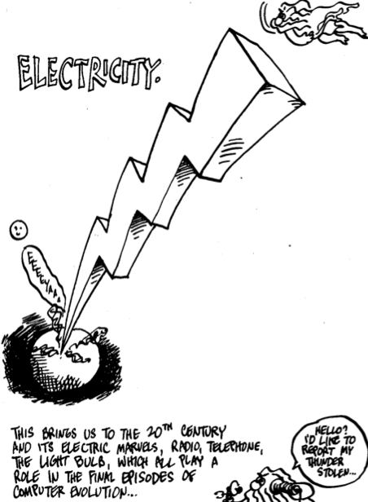

Slide 42
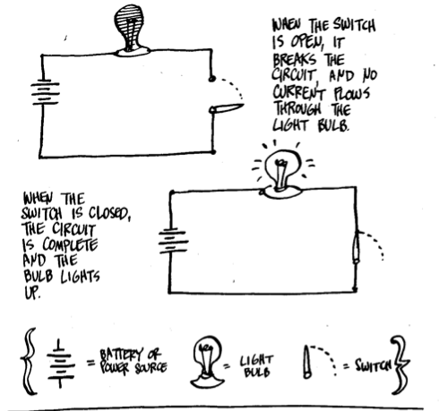

Slide 43

FIRST GENERATION, 1951 – 1958: The Vacuum Tube
The first generation of computers, characterized by vacuum tubes, started in 1951 with the creation of -
UNIVAC (Universal Automatic Computer) – a tabulating machine which won the contest for the fastest machine which could count the US 1890 census.
VACUUM TUBES (electronic tubes about the size of light bulbs) were used for circuitry and magnetic drums for memory.

Slide 44
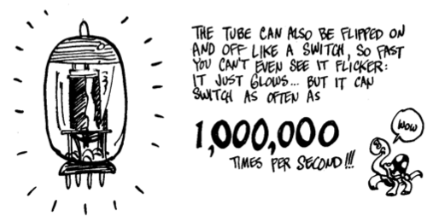

Slide 45
Relied on machine language, the lowest-level programming language understood by computers.
Input was based on punched cards and paper tape, and output was displayed on printouts.
Ex. UNIVAC, ENIAC(Electronic Numerical Integrator and Calculator)

Slide 46
DISADVANTAGES:
They generate more heat causing many problems in temperature regulation and climate control.
Tubes were subject to frequent burn-out.
Very huge in size.
High electricity consumption.
Very expensive to maintain.

Slide 47
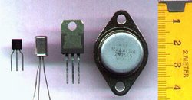
SECOND GENERATION, 1959 – 1964: The Transistor
The year 1959 marked the invention of transistors, which characterized the second generation of computers.
TRANSISTOR – was a three-legged component which shrunk the size of the first generation computers. Occupied only 1/100th of the space occupied by a vacuum tube
More reliable, had greater computational speed, required no warm-up time and consumed far less electricity.

Slide 48
smaller, faster, cheaper, more energy-efficient and more reliable.
Still relied on punched cards for input and printouts for output.
Moved to assembly language from binary language.
Also used magnetic core technology instead of magnetic drums.

Slide 49

THIRD GENERATION, 1965 – 1970: The Integrated Circuit
Third generation computers arose in 1965 with the invention of smaller electronic circuits called integrated circuits (IC’S)
INTEGRATED CIRCUITS – are square silicon chips containing circuitry that can perform the functions of hundreds of transistors.

Slide 50
ADVANTAGES:
RELIABILITY – Unlike vacuum tubes, silicon will not break down easily. It is very seldom that you will have to replace it.
LOW COST – Silicon chips are relatively cheap because of their small size and availability in the market. It also consumes less electricity.
Speed – the speed of the system increased drastically.
Instead of punched cards and printouts the users interacted with keyboards and monitors interfaced with OS.

Slide 51

FOURTH GENERATION, 1971 – present: The Microprocessor
Marked by the use of microprocessor
MICROPROCESSOR – is a silicon chip that contains the CPU – part of the computer where all processing takes place.
Thousands of ICs were built onto a single silicon chip.

Slide 52
The Intel 4004 chip, developed in 1971, located all the components of the computer—from the central processing unit and memory to input/output controls—on a single chip.
As these small computers became more powerful,
they could be linked together to form networks, which eventually led to the development of the Internet.
Fourth generation computers also saw the development of GUIs, the mouse and handheld devices.

Slide 53
Fifth Generation
Still in development
Based on Artificial intelligence.
The goal of fifth-generation computing is to develop devices that respond to natural language input and are capable of learning and self- organization.

Slide 54
TODAY’S COMPUTER
is classified as fourth generation computers.
faster, more powerful, tremendous data storage and processing capacity
new brands and models would come out the market almost every other month.
many clones or imitations of the IBM have become even more powerful and a lot cheaper.

Slide 55
computers became more affordable
computers can now be found in homes, schools, offices etc.
there has been a tremendous improvement in software technology
different software applications to choose from: word processing, spreadsheets, database management, games and entertainment.
computer subjects are now being offered not just to college students but even to high school and elementary.
computers are now used as an aid in teaching etc.

Slide 56
What are some general trends in computers?
Moore’s Law: Computing power doubles approximately every 18 months
Faster processors
Bigger storage capacity
Bigger memory
Stand alone>>>Network>>>Distributive computing
Lower cost

